Slide 1

Overview of Blockchain Consensus Mechanisms
Cork Blockchain, 2018-08-14
Johannes Ahlmann, johannes@fluquid.com
Image: https://cdn-images-1.medium.com/max/1600/1*DpVNUugFmEhGhblHmXxbVA.jpeg

Slide 2

Consensus Mechanism
"A fault-tolerant mechanism
that is used to achieve the necessary agreement
on a single data value or a single state of the network
among distributed processes or multi-agent systems."
https://www.toolshero.com/wp-content/uploads/2017/09/consensus-oriented-decision-making-codm-toolshero-696x348.jpg

Slide 3
Byzantine Fault Tolerance
"Crash Fault Tolerance" (CFT) aims to guarantee the functioning of a distributed system in the presence of machines crashing or disconnecting and reconnecting at random
"Byzantine Fault Tolerance" (BFT) aims to guarantee the ability of a group of nodes to achieve consensus in the presence of malicious actors who are trying to subvert the consensus process in their favour, or prevent consensus from being achieved.
BFT is a much harder goal than CFT, and hasn't been solved mathematically at scale; BFT generally makes use of cryptographic signatures, etc.
Approximations of BFT exist, but they all come with significant constraints and limitations attached (i.e. Practical BFT achieve consensus in the presence of up to 1/3 malicious actors and <20 total nodes)

Slide 4
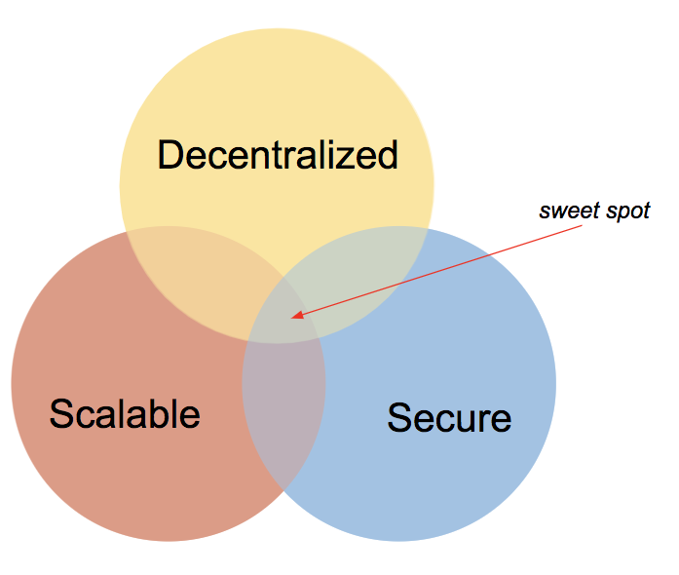
The Scalability Trilemma
Each of the three goals by itself is "easy" to achieve
But you have to sacrifice one of Decentralization, Scalability or Security to achieve a high level in the other two
Bitcoin sacrifices scale (to some degree) for decentralization and security
Ripple, Stellar, EOS sacrifice decentralization (to some degree) for scale and security
Related to CAP Theorem for Distributed Data Stores:
Consistency
Availability
Partition Tolerance
https://cdn-images-1.medium.com/max/1600/1*wB2_druDLJECNI9NGEcrqQ.png

Slide 5
Consensus Mechanisms
Mechanisms
Proof of Work
Proof of Stake
DPoS
Proof of Burn
Proof of Authority
Byzantine Fault Tolerance
Proof of Importance
PoET

Slide 6

Proof of Work
Uses scarce resource, i.e. electricity to perform a fair lottery for block creation and chain selection
Probability of receiving block reward is roughly proportional to "work performed" / "energy burnt"
Performs:
chain selection
coin distribution
who produces blocks
when blocks are produced
Not a mathematical solution, but a game theoretical mechanism that leverages monetary and other incentives to "keep people honest"
Bitcoin would not work if coins did not have a financial value
Examples: Bitcoin, most cryptocurrencies
https://en.bitcoinwiki.org/upload/en/images/thumb/5/55/Ea5b21f014547b4b44cf2dafcd76aad2.jpg/400px-Ea5b21f014547b4b44cf2dafcd76aad2.jpg

Slide 7
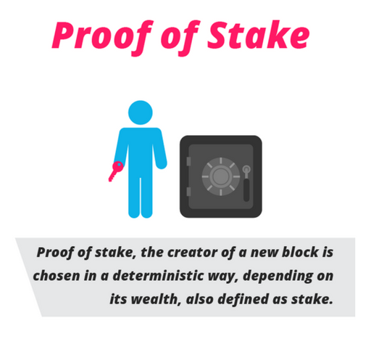
Proof of Stake
Staked amount is locked away and can't be accessed for a time period, and can be forfeit if the created block is invalid
Probability of receiving "minting fee" is proportional to the amount staked
Pros
less electricity usage
stronger alignment of incentives (miners vs. coin holders)
mining centralization, ASIC
Cons
Naive PoS only addresses chain selection
The rich are getting richer
Risk of Loss of Funds (stakes need to be in hot wallet)
BFT-based
Tendermint, Ethermint
Chain-based
Ethereum Casper, NXT, PeerCoin, Decred (hybrid), Dash, NEO, Stratis, Lisk, PIVX
https://cdn-images-1.medium.com/max/1600/0*IVoaV2-p8z3mWsST.png

Slide 8
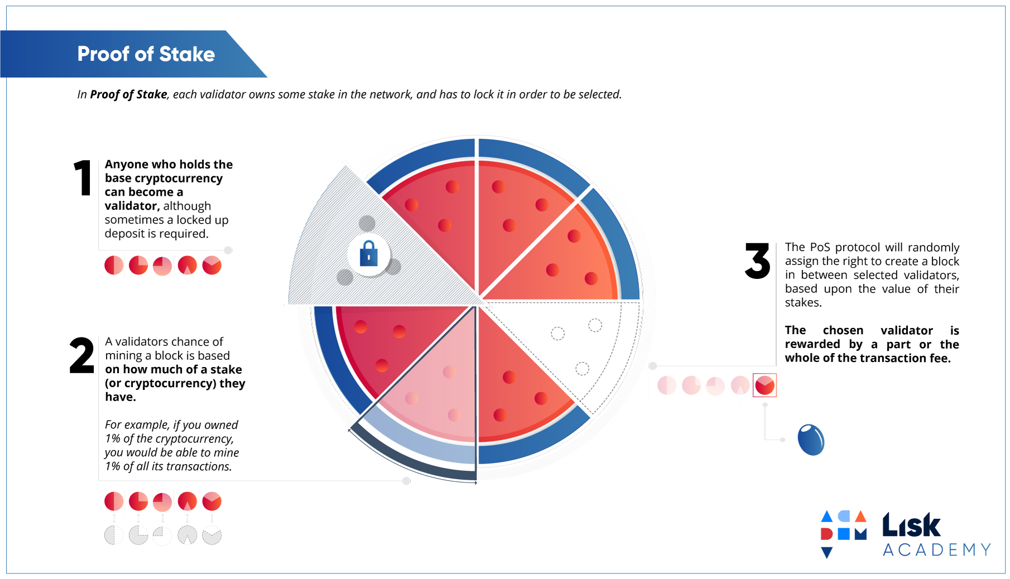
https://lisk.io/content/5-academy/2-blockchain-basics/4-how-does-blockchain-work/8-proof-of-stake/8-pos-infographic.jpg

Slide 9
Delegated Proof of Stake
Nodes vote for Witnesses (top 100 are paid, top 20 earn a regular salary), nodes can withdraw their vote in case of improper conduct by a Witness
Relies upon a group of delegates to validate blocks on behalf of all nodes in the network
Pros: Scalable, energy efficient, cheap transactions.
Cons: Partially centralized
Examples: Bitshares, EOS, Steemit

Slide 10

Proof of Burn
Generate a random target address; it is infeasible to find the private key for a given public address
Send existing coins to this unspendable address as "proof of burn". The tokens cannot never be recovered
Selected block mining probability proportional to burnt coins, or use "proof of burn" to bootstrap/ seed new coins
Examples: SlimCoin, CounterParty (for seeding)
https://cointelegraph.com/news/the-full-story-of-cannabiscoins-premine-burn

Slide 11


Proof of Elapsed Time (PoET)
Nodes need to be identifiable and accepted into the network (permissioned blockchain)
Uses Trusted Hardware for "fair lottery". Every node generates a random number for how long it has to wait, and the random number utilitizes Trusted Computing hardware.
Requires "Intel Software Guard Extensions (SGX)" on node CPUs
Examples: Hyperledger Sawtooth
https://www.hyperledger.org/wp-content/uploads/2018/01/Hyperledger_Sawtooth_Logo_Color.png
http://www.stickpng.com/assets/images/58568d224f6ae202fedf2720.png

Slide 12

Proof of Authority
Stakes social capital, rather than financial capital
By identifying validators, PoA consensus becomes inherently centralized. Therefore, it’s best suited for private blockchains and consortiums
Validators should be scarce, so there is a desire to hold the title.
Nodes "stake their reputation"
Inherently centralized
Examples: Parity/ Kovan, Rinkeby, VeChain
https://cdn-images-1.medium.com/max/1500/1*vQ3fRvhuKa1gt1KYscIsrg.png

Slide 13
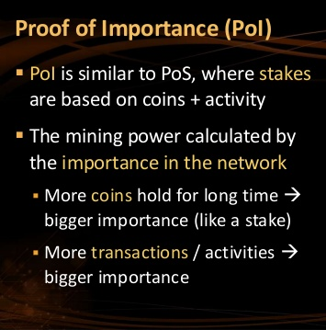
Proof of Importance
Proof of Importance recognizes that other factors (than staked amount and coin hold time) can be taken into account when determining what nodes provide the most value to a network
Key factors:
Net transfers, or total spent in the last 30 days.
Vested amount of currency to create blocks.
Nodes that are clustered, aka more intermingled, are more heavily weighted.
Examples: XEM
Image: https://www.slideshare.net/nakov/consensus-algorithms-nakov-jprofessionals-jan-2018

Slide 14

Byzantine Fault Tolerance
Centralized, Permissioned
Can tolerate 1/3 malicious nodes
Variants, Applications
Practical BFT (PBFT), Istanbul - don't scale beyond 20 nodes
Redundant BFT (RBFT)
Federated Byzantine Agreement (Stellar, Ripple)
Honeybadger
https://www.iconspng.com/image/40058/byzantine-generals-problem

Slide 15
Attacks on Proof of Stake
Nothing at Stake
Staker can stake on all candidate chains; and will be seen as having staked on whichever chain ultimate "wins"
This can in principle be detected, but changing stakes is necessary for convergence. Explicit multiple staking rounds addresses this to some degree
Stake does not add to the convergence of the system; In contrast for PoW energy is a real-world finite resource
Long Range Attack
Attacker could buy a key to an address that is now empty but had a large token balance in the past, and generate alternative history from that point
Solution: checkpointing Problem: checkpointing introduces centralization/"ask a friend" security model

Slide 16
Thank You!

Slide 17
Resources
https://medium.com/the-daily-bit/9-types-of-consensus-mechanisms-that-you-didnt-know-about-49ec365179da
https://cointelegraph.com/news/why-blockchain-needs-proof-of-authority-instead-of-proof-of-stake
https://blog.cosmos.network/consensus-compare-casper-vs-tendermint-6df154ad56ae
https://blog.bitmex.com/complete-guide-to-proof-of-stake-ethereums-latest-proposal-vitalik-buterin-interview/

